Slide 1

System & Network Administration
BY EMAN MEHMOOD

Slide 2
System & Network Administration
BS Information Technology – 5th Semester
Department of Information Technology
Government College University
Lecture 2: Command-Line Administration

Slide 3
Command-Line Administration
Command-line administration is the process of managing and controlling a computer system or server by entering text-based commands through a command-line interface (CLI).
Instead of using graphical menus and buttons, an administrator types commands to perform tasks such as creating users, managing files, checking system resources, configuring networks, starting and stopping services, installing software, and troubleshooting problems.
Command-line administration is especially important for servers because servers are often managed remotely and may operate without a graphical user interface.

Slide 4
What is a Command-Line Interface?
A Command-Line Interface (CLI) is a text-based environment where users interact with an operating system by typing commands.
When a command is entered, the operating system interprets it and performs the requested operation. The system then displays the result, an error message, or another response.
For example:
C:\> dir
The dir command asks Windows to display the files and folders in the current directory.
On Linux:
$ ls
The ls command performs a similar task.
The CLI provides administrators with direct and precise control over the operating system.

Slide 5
CLI vs Graphical User Interface
A Graphical User Interface (GUI) allows users to interact with a computer using windows, icons, menus, buttons, and a mouse.
A CLI uses typed commands to perform the same or more advanced operations.
For example, creating a folder through a GUI requires opening a file manager, navigating to a location, and selecting the appropriate option. Through the command line, an administrator can simply enter:
mkdir Projects
The CLI is generally faster for repetitive administrative tasks, easier to automate, and particularly useful for remote server management.

Slide 6
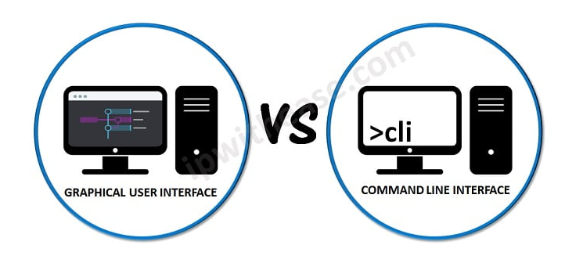
CLI vs Graphical User Interface

Slide 7
Why System Administrators Use the Command Line
System administrators use the command line because it provides speed, automation, flexibility, and detailed control.
A single command can perform an operation that would require several GUI steps. Commands can also be combined into scripts so that hundreds or thousands of systems can be managed automatically.
The command line is also useful when a server has no graphical interface, when network bandwidth is limited, or when an administrator needs to troubleshoot a system remotely.
For professional system administrators, command-line skills are therefore an essential part of server management.

Slide 8
Common Command-Line Environments
Different operating systems provide different command-line environments.
Windows commonly provides:
Command Prompt (cmd)
PowerShell
Windows Terminal
Linux and other Unix-like systems commonly use:
Bash
Zsh
Sh
Other shells
A shell acts as an interface between the administrator and the operating system. It receives commands, interprets them, and requests the operating system to perform the required operation.

Slide 9
Windows Command Prompt
Command Prompt, commonly called cmd, is the traditional command-line environment in Windows.
It provides commands for managing files, directories, processes, networking, users, and system configuration.

Slide 10
Continue…
Examples include:
dir
cd
mkdir
copy
move
del
ipconfig
ping
tasklist

Slide 11
Continue….
For example:
C:\Users\Admin> ipconfig
displays information about the computer's network configuration.
Although PowerShell provides more advanced capabilities, Command Prompt is still useful for basic administration and troubleshooting.

Slide 12

Windows PowerShell
PowerShell is a more powerful command-line shell and scripting environment developed by Microsoft for system administration and automation.
Unlike traditional Command Prompt, PowerShell works extensively with structured objects rather than only plain text.

Slide 13
Continue….
For example:
Get-Process
Displays information about running processes.
Another example:
Get-Service
Displays Windows services.
PowerShell can be used to manage users, services, processes, files, networks, Windows features, and many other components of Windows systems.

Slide 14
Linux Shell and Terminal
Linux administrators commonly use a terminal together with a shell such as Bash.
A typical Linux command looks like:
ls
The shell interprets the command and asks the operating system to perform the requested action.
Some frequently used Linux commands include:
Pwd, ls, cd, mkdir, cp, mv, rm, cat, grep, ps, top, ip, ping
Linux servers are frequently administered through the command line, particularly when they operate without a desktop environment.

Slide 15
Basic Structure of a Command
Most command-line instructions follow a simple structure:
command + options + arguments
For example:
ls -l /home
Here:
ls is the command.
-l is an option that changes how the command behaves.
/home is the argument specifying what should be examined.

Slide 16
Continue….
Windows commands may use a different syntax. For example:
ipconfig /all
The command is ipconfig, while /all requests additional network information.
Understanding command syntax makes it easier to learn new commands.

Slide 17


